Slide 1
Course 11

Slide 2
Structure of compiler
analysis
Source program
scanning
parsing
semantic analysis
generate intermediary code
optimize intermediary code
generate object code
Sequence of tokens
Syntax tree
Annotated abstract syntax tree
synthesis
Intermediary code
Optimized intermediary code
Object program

Slide 3
Semantic analysis
Parsing – result: syntax tree (ST)
Simplification: abstract syntax tree (AST)
Annotated abstract syntax tree (AAST)
Attach semantic info in tree nodes
Example

Slide 4
Semantic analysis
Attach meanings to syntactical constructions of a program
What:
Identifiers -> values / how to be evaluated
Statements -> how to be executed
Declaration -> determine space to be allocated and location to be stored
Examples:
Type checkings
Verify properties
How:
Attribute grammars
Manual methods

Slide 5
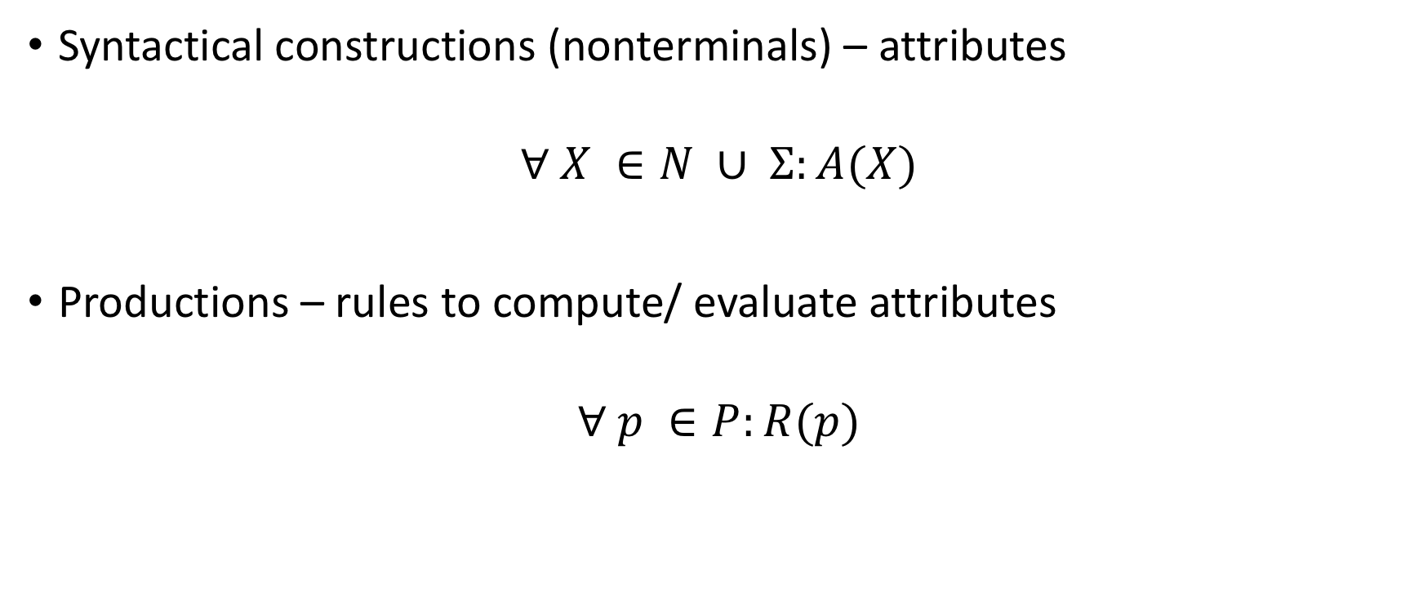
Attribute grammar
Syntactical constructions (nonterminals) – attributes
$$∀ X ∈N ∪ Σ:A(X)$$
Productions – rules to compute/ evaluate attributes
$$∀ p ∈P:R(p)$$

Slide 6
Definition
AG = (G,A,R) is called attribute grammar where:
G = (N,𝜮,P,S) is a context free grammar
A = {A(X) | X ∈N U 𝜮} – is a finite set of attributes
R = {R(p) | p ∈P} – is a finite set of rules to compute/evaluate attributes

Slide 7
Example 1
G = ({N,B},{0,1}, P, N}
P: N -> NB
N -> B
B -> 0
B -> 1
N₁.v = 2* N₂.v + B.v
N.v = B.v
B.v = 0
B.v = 1
Attribute – value of number = v
Synthetized attribute: A(lhp) depends on rhp
Inherited attribute: A(rhp) depends on lhp

Slide 8
Evaluate attributes
Traverse the tree: can be an infinite cycle
Special classes of AG:
L-attribute grammars: for any node the depending attributes are on the “left”;
can be evaluated in one left-to-right traversal of syntax tree
Incorporated in top-down parser (LL(1))
S-attribute grammars: synthetized attributes
Incorporated in bottom-up parser (LR)

Slide 9
Steps
What? - decide what you want to compute (type, value, etc.)
Decide attributes:
How many
Which attribute is defined for which symbol
Attach evaluation rules:
For each production – which rule/rules

Slide 10
Example 2 (L-attribute grammar)
ListId.type = DeclTip.type
Id.type = ListId.type
ListId₂.type = ListId₁.type
Id.type = ListId₁.type
Decl -> DeclTip ListId
ListId -> Id
ListId -> ListId, Id
Attribute – type
int i,j

Slide 11
Example 3 (S-attribute grammar)
ListDecl₁.dim = ListDecl₂.dim + Decl.dim
ListDecl.dim = Decl.dim
Decl.dim = Type.dim * ListId.no
Type.dim = 4
Type.dim =8
ListId.no = 1
ListId₁.no = ListId₂.no + 1
ListDecl -> ListDecl; Decl
ListDecl -> Decl
Decl -> Type ListId
Type -> int
Type -> long
ListId -> Id
ListId -> ListId, Id
Attributes – dim + no – for which symbols
int i,j; long k

Slide 12
Proposed problems (HW):
Define an attribute grammar for arithmetic expressions
Define an attribute grammar for logical expressions
Define an attribute grammar for if statement

Slide 13
Manual methods
Symbolic execution
Using control flow graph, simulate on stack how the program will behave
[Grune – Modern Compiler Design]
Data flow equations
Data flow – associate equations based on data consumed in each node (statement) of the control flow graph: In, Out, Generated, Killed
[Grune – Modern Compiler Design], [Kildall], [course]

Slide 15
Generation of intermediary code

Slide 16
Structure of compiler
analysis
Source program
scanning
parsing
semantic analysis
generate intermediary code
optimize intermediary code
generate object code
Sequence of tokens
Parse tree
Annotated syntax tree
synthesis
Intermediary code
Optimized intermediary code
Object program

Slide 17
Generate intermediary code

Slide 18
Forms of intermediary code
Java bytecode – source language: Java
– machine language (dif. platforms) JVM
MSIL (Microsoft Intermediate Language)
– source language: C#, VB, etc.
– machine language (dif. platforms) Windows
GNU RTL (Register Transfer Language)
– source language: C, C++, Pascal, Fortran etc.
– machine language (dif. platforms)

Slide 19
Representations of intermediary code
Annotated tree: intermediary code is generated in semantic analysis
Polish postfix form:
No parenthesis
Operators appear in the order of execution
Ex.: MSIL
3 address code
Exp = a + b * c ppf = abc*+
Exp = a * b + c ppf = ab*c+
Exp = a * (b + c) ppf = abc+*

Slide 20
3 address code
= sequence of simple format statements, close to object code, with the following general form:
< result >=< arg1 >< op >< arg2 >
Represented as:
Quadruples
Triples
Indirected Triples

Slide 21
Quadruples:
< op > < arg1 > < arg2 > < result >
Triples:
< op > < arg1 > < arg2 >
(considered that the triple is storing the result)

Slide 22
Special cases:
Expressions with unary operator: < result >=< op >< arg2 >
Assignment of the form a := b => the 3 addresss code is a = b (no operatorand no 2nd argument)
Unconditional jump: statement is goto L, where L is the label of a 3 address code
Conditional jump: if c goto L: if c is evaluated to true then unconditional jump to statement labeled with L, else (if c is evaluated to false), execute the next statement
Function call p(x1, x2, ..., xn) – sequence of statements: param x1, param x2 , param xn, call p, n
Indexed variables: < arg1 >,< arg2 >,< result > can be array elements of the form a[i]
Pointer, references: &x, ∗x

Slide 23
Example: b∗b−4∗a∗c
op | arg1 | arg2 | rez
* | b | b | t1
* | 4 | a | t2
* | t2 | c | t3
- | t1 | t3 | t4
nr | op | arg1 | arg2
(1) | * | b | b
(2) | * | 4 | a
(3) | * | (2) | c
(4) | - | (1) | (3)

Slide 24
Example 2
If (a<2) then a=b else a=b*b

Slide 25
Optimization of intermediary code

Slide 26
Structure of compiler
analysis
Source program
scanning
parsing
semantic analysis
generate intermediary code
optimize intermediary code
generate object code
Sequence of tokens
Parse tree
Annotated syntax tree
synthesis
Intermediary code
Optimized intermediary code
Object program

Slide 27
Optimize intermediary code
Local optimizations:
Perform computation at compile time – constant values
Eliminate redundant computations
Eliminate inaccessible code – if…then...else...
Loop optimizations:
Factorization of loop invariants
Reduce the power of operations

Slide 28
Eliminate redundant computations
Example:
D:=D+C*B A:=D+C*B C:=D+C*B

Slide 29
Determine redundant operations
Operation (j) is redudant to operation (i) with i<j if the 2 operations are identical and if the operands in (j) did not change in any operation between (i+1) and (j-1)
Algorithm [Aho]

Slide 30
Factorization of loop invariants
What is a loop invariant?

Slide 31
Challenge
V1:
P = a[0]
For i=1 to n
P = P + a[i]*v^i
V2:
P = a[0]
Q=v
For i=1 to n
P = P + a[i]*Q
Q = Q*v
Consider n, and a[i] i=0,n the coefficients of a polynomial P.
Given v, write an algorithm that computes the value of P(v)
3 solutions
P(x) = a[n]*x^n+ … + a[1]*x + a[0] = (a[n]*x^(n-1)+ … + a[1])*x + a[0]
V3
P=a[n]
For i=1 to n
P = P*v + a[n-i]

Slide 32
Reduce the power of operations

